Slide 1




Peafowl: In-application CPU Scheduling to Reduce Power Consumption of In-memory Key-Value Stores
Showan Esmail Asyabi, Azer Bestavros, Erfan Sharafzadeh, and Timothy Zhu

Slide 2
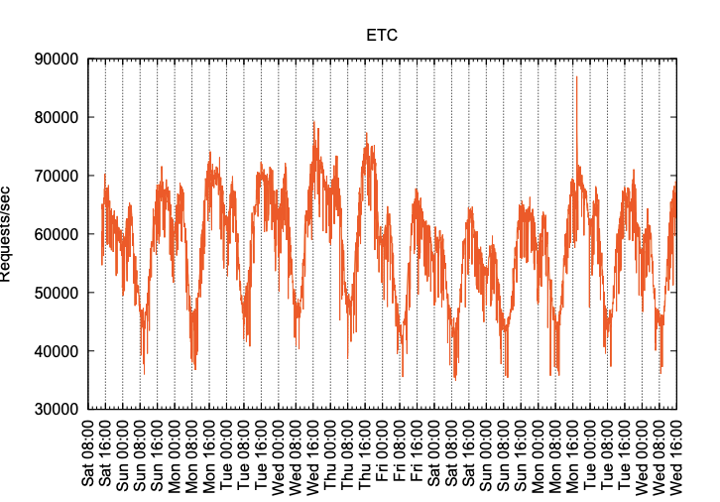
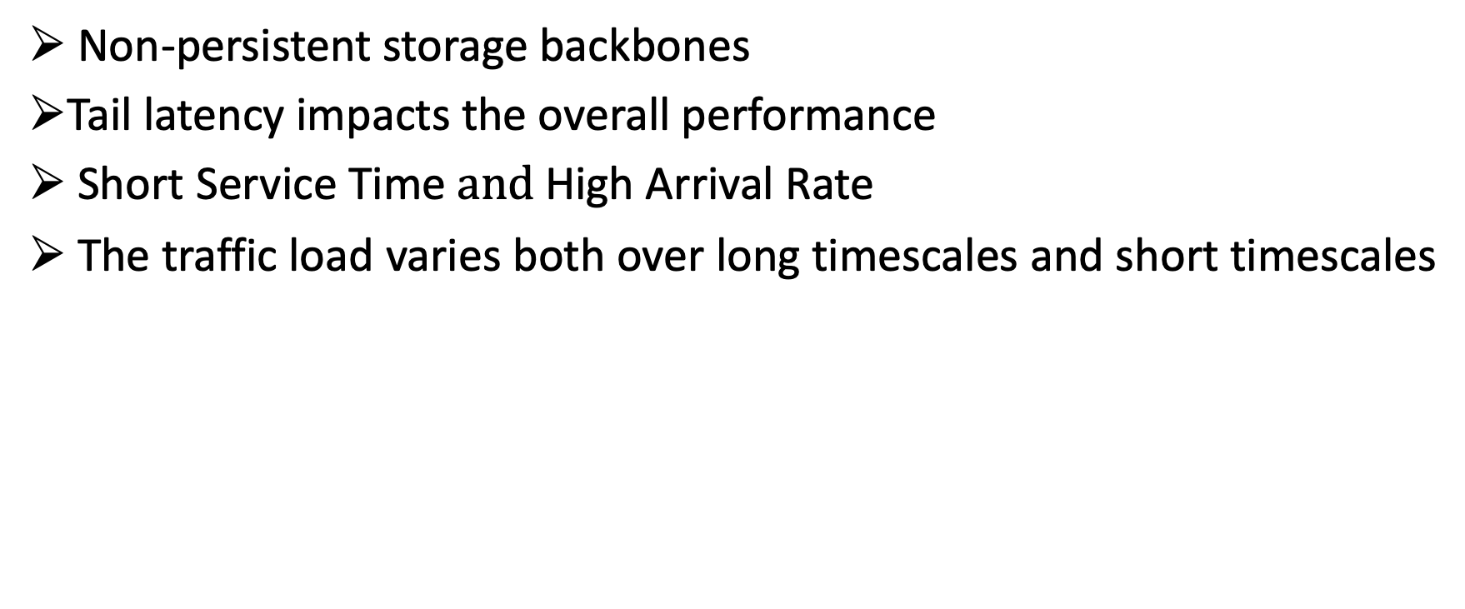
In-memory Key-Value stores
Non-persistent storage backbones
Tail latency impacts the overall performance
Short Service Time $and$High Arrival Rate
The traffic load varies both over long timescales and short timescales
Long-term variations can be leveraged to right-size the amount of resources allocated to KV stores
Challenge to build KV stores to elastically scale to short-term bursts in workloads

Slide 3
Elastic KV store requirements
Energy proportionality
Scaling the processing capacity to match the available work
Raises CPU efficiency in data centers
Microsecond-scale tail latency
high fan-out
Tail of the latency distribution (e.g., 99th percentile) rather than average latency
Ease of deployment, Generality
Solutions that rely on significant modifications to the OS or device drivers are less practical
we argue that any suggested solution must be readily deployable in data centers

Slide 4
Existing systems
Idle States (Sleep States)
DVFS and Request Delaying
Feedback-Based Controllers

Slide 5

Idle states
CPUs feature several power saving modes called c-states
Idle states:
C0 – operational mode – no power saving
C1
C1e
C6 – deepest idle state - wakeup latency= 133𝜇s
Transitions to deep c-states are costly
Target residency time of the c-state (e.g., 600𝜇s residency time for C6 )
High arrival rates and short service times of KV store workloads fragments idle periods into very short idle cycles
CPUs cannot enter a deep enough sleep state (e.g., C6) to be effective
Mutilate
Memcached

Slide 6




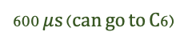
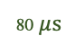
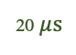
DVFS and Request delaying
Exploit the latency slack to slow down request processing by adjusting the CPU frequency
limited DVFS frequency ranges
Frequency transition latency
Exploit the latency slack to delay request processing through sleep states
Effective for relaxed target latency
10 $μ$s
90 $μ$s
50 $μ$s
200$μ$s
50
2GHz
0
400
0
100
800
50
1GHz
400
800
0
100
0
20 $μ$s
80 $μ$s
600 $μ$s (can go to C6)
Short service times and high arrival rates of KV stores do not provide much opportunity for power saving with these approaches

Slide 7
Feedback-based controllers
Periodically monitor and measure the load, compare it to predefined thresholds
Scale the number of active cores to save power during periods of low or medium utilization
Controller
Application
OS
Feedback-based controllers can adapt to diurnal variations
Too slow to cope with short-term burstiness, lengthening tail latency
They rely on the operating system to schedule KV store, aggravating microsecond-scale tail latency

Slide 8
Peafowl
An elastic in-memory KV store designed to exploit load variability to save power while maintaining low microsecond-scale tail latency
The key insight behind Peafowl’s design is to handle the scheduling in the application rather than the operating system
Energy proportionality
Peafowl’s scheduler leverages in-application knowledge to carefully consolidate the load among fewer CPU cores during off-peak period
Keeping latency at microsecond scale
Peafowl eliminates the millisecond-scale tail latency impact of OS scheduling
Peafowl to monitor load in fine-grained intervals and immediately distribute load when needed
Generality and ease of deployment
Peafowl entirely implemented in user space
Peafowl does not rely on third party monitoring services or feedback-based controllers
It does not require any OS modification or privileged components.

Slide 9
PEAFOWL
Scheduler
Worker
Peafowl’s main components:
Monitoring
Scale-up algorithm
Scale-down algorithm
Application
OS

Slide 10
Monitoring
Peak load
Load
Time
Peafowl dispatches newly created connections among workers in a round-robin fashion.
It assigns this initial worker as the connection’s home worker
resident connection and guest connection
Each worker learns the peak load
Peak load establish a baseline performance goal
Application
OS

Slide 11
Scale-Down Process
Load
Scale-down worker
Destination worker
Scale-down worker
Destination worker
Instruct the scale-down worker to transfer one connection to the destination worker
Moving connections one at a time
Once all connections are migrated, enables idle-state
Time
Application
OS

Slide 12
Scale-up Process
Load
Time
Application
When a worker’s load approaches its load limit the worker starts migrating some guest connections back to their home worker
Workers are able to independently respond to load increases immediately
This conservative approach allows Peafowl to maintain low tail latencies
OS

Slide 13
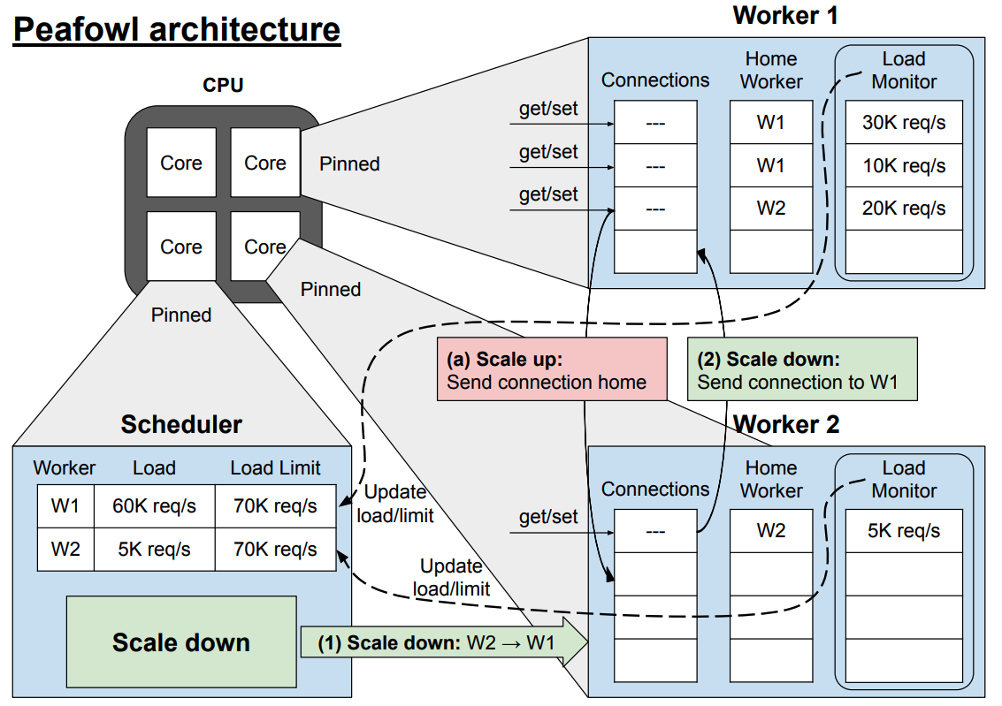
Peafowl Implementation

Slide 14
EVALUATION
We implement Peafowl in C as an extension of Memcached.
Our evaluation of Peafowl addresses the following questions:
How well does Peafowl perform when facing real-world workload patterns?
How do Peafowl’s internal mechanisms contribute to its observed performance?
How does Peafowl compare to the state-of-the-art approaches?
Experimental setup
We use one dual-socket server machine equipped with 12-core Intel Xeon 4116 CPUs running at 2.1 GHz and 32 GB of RAM
We generate load using one dual socket client machine equipped with 32-core Intel Xeon CPUs running at 2.6 GHz and 64 GB of RAM

Slide 15
Real-world Scenarios – Power Consumption

Slide 16
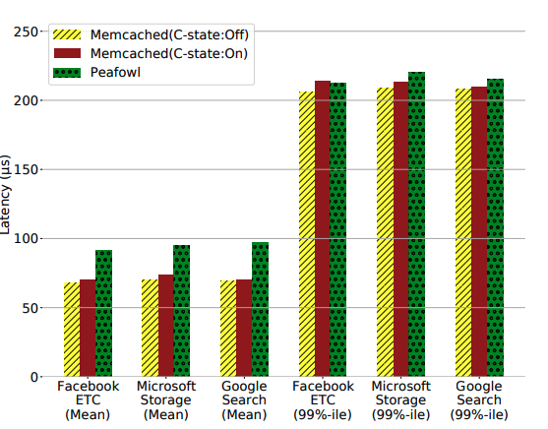
Real-world Scenarios – Latency

Slide 17
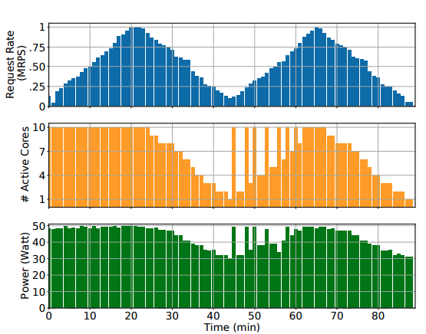
Microbenchmarks

Slide 18
Peafowl compared to state-of-the-art
Rubik
Exploits latency slack and slowing down request processing through DVFS
Rubik adjusts frequency upon arrival and completion of each request
𝜇DPM
exploits latency slack by delaying the processing of requests
Idle-state Governors (CISG)
Combine several factors as a heuristic to predict the upcoming idle duration

Slide 19
Power Consumption

Slide 20
Latency

Slide 21
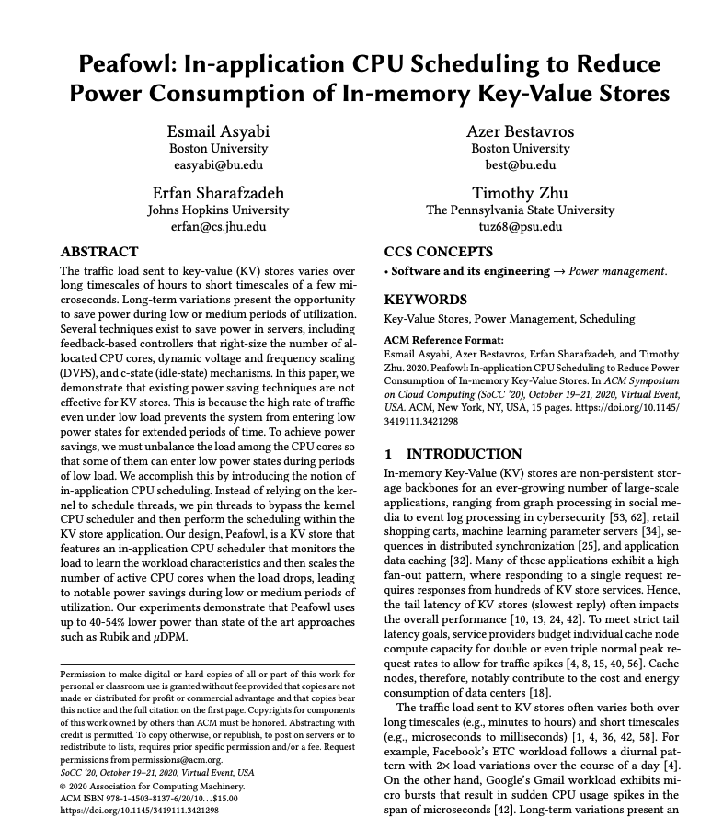
Conclusion
Peafowl saves power while keeping tail latency at microsecond scale
The KV store itself is in charge of scheduling
Monitors the load, learns the peak load
When the load drops, it consolidates the load among a fewer CPU cores
Peafowl achieves up to 40-54% lower power consumption.
Peafowl does not rely on any third party applications, run-times, custom hardware, kernel modules, or any changes to the underlying OS

